Slide 1
Unit 8 Standard Form (Intercepts)
Integrated mathematics 9

Slide 2
Find the x and y intercept of a line.
$$−8x+7y=56$$
Set y = 0 to solve for x-intercept
Set x = 0 to solve for y-intercept.

Slide 3
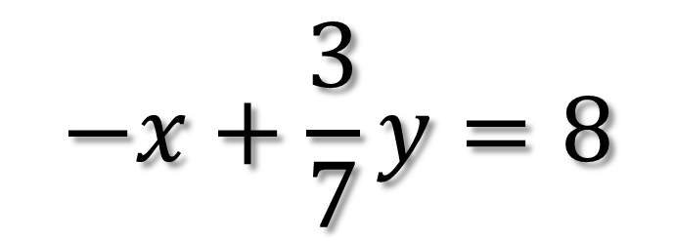
Find the x and y intercept of a line.
$$−x+\frac{3}{7}y=8$$
Set y = 0 to solve for x-intercept
Set x = 0 to solve for y-intercept.

Slide 4
